Slide 1
Kick-off meeting

Slide 2
Agenda
1 - Introduction 10”
2 - Solvay moving to Google & Chromebook 10”
3 - CREW program for Marketing & Sales 15”
4 - Q&A 15”
5 - Next steps 5”

Slide 3
1 - Introduction

Slide 4
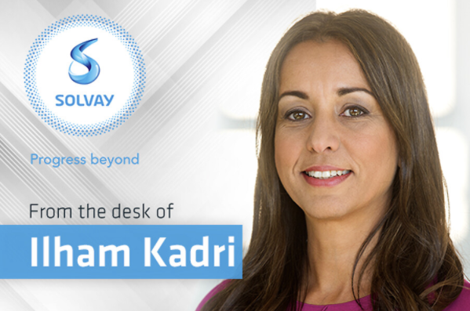
Introduction
You have been identified as eligible to receive a Chromebook. This analysis has been done with your entity & your site in addition of SBS IT tools + the application analysis Gform that you have received and completed.
We are happy to have you onboard ! Let’s start this transformation journey together
In line with S3 - Fuel for Growth and the IT playbook, Chromebook and Google workspace have been chosen as the solution to answer the need of New Ways of Working
We count on your collaboration to work together. Everyone as individual can have an impact and make a difference.
A full team is dedicated to this project, providing trainings, change management workshop and virtus onboarding
Notes:
USER ONBOARDING MESSAGE
10’ introduction - Key message Chromebook is not an option (link) / show the example / in front of the customer / be ambassador / we are all driver of the project
10’ Jamboard feedback / status / contribute
How do you feel using only Chromebook and Google tools ? What are the weakness ? Their needs and expectation from the project to become autonomous ?
20”Project presentation & Expectations what we expect from them “We can help you only if you help us”
10” Jamboard How do you see your role in this project ? How can you contribute ?
10” next step

Slide 5
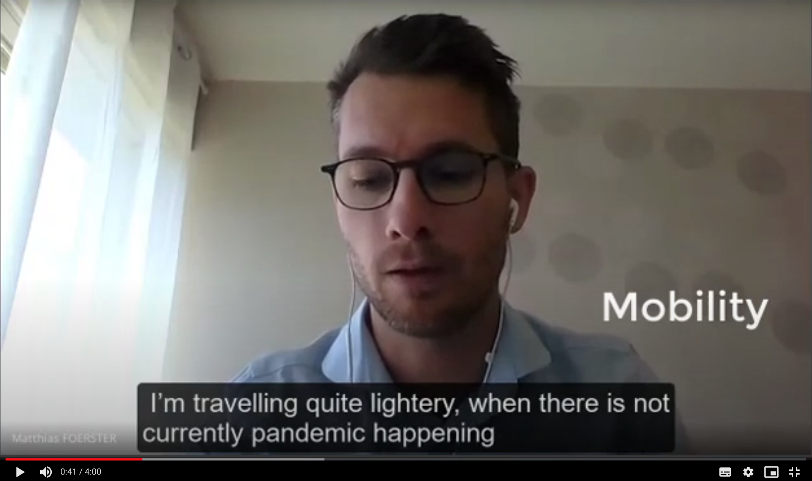
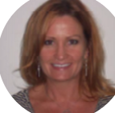
Chromebook testimony at Novecare
“For me mobility is the most important thing, so lightweight computers who work immediately and don’t waste your time. This is exactly what I found with the Chromebook.”
Matthias Foerster,
Regional Market Director EMEA, Novecare GBU
“I do indeed love my chromebook. It was an easy adjustment. the main reason I prefer Chromebook is because I don't have to continually restart my computer for updates. I was getting the restart message a couple of times per week. I also like the fact that when I do restart, all the tabs I had open are still there. The Chromebook has a quicker response than my old PC as well.”
Pam Accardi, Commercial Excellence & Digital Analyst, Novecare GBU
“Chromebook facilite grandement la collaboration entre les employés Solvay. Cette collaboration peut être rendue plus délicate lorsqu'il s'agit de collaborer avec des clients ou partenaires extérieurs n'ayant pas accès aux outils Google. Dans l'ensemble, j'en suis très satisfait."
Vincent Miralles, Transformation Management, Novecare GBU

Slide 6
2 - Solvay moving to Google and Chromebook

Slide 7
Fuel For Growth Initiatives and IT Playbook
IT Playbook
Primary Usage of Google Workspace
Microsoft Office only for very specific needs, on exception basis.
Chromebook is the device by default
Accessories / Peripherals Employees of sites moving to SWOW are eligible to transportable accessories
Mobile workers no fixed device, re-use transportable accessories supplied for SWOW offices, no duplicated screen
Only Google Drive, Share Drive and AODocs are the only applications available for storage of data. Any other applications will be disabled.
No File server, no PC back-up is the norm
BYOD for external & internals where possible with allowance in compliance with Solvay Security & standards (start mid-2021)
No printing is the norm
Trainees and short-term employee will be provided 2nd hand devices by default - unless validated for emergency
no Solvay IT devices are provided to externals / contractors / trainees on activity for Solvay . Any exception should be justified and validated. Pool available for emergency
SOLVAY
WAY OF WORKING
BEHAVIORS
BRICKS
BYTES
BRANDING
Solvay One Planet

Slide 8
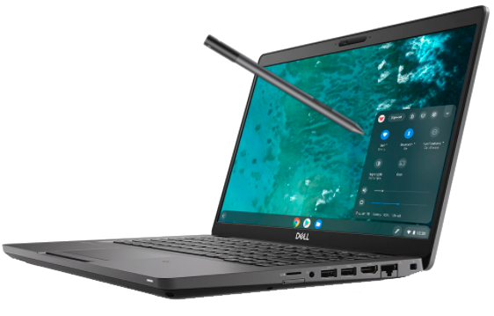
Vision, mission & scope
WHY
HOW
Secure data
CREW 6 weeks change management program
Supported by a multidisciplinary team of experts
Improve collaboration & reinvent ways of working
Faster & ready to collaborative work environment
Continuous improvement based on feedback
Chromebook promoters & sponsors per job domain
Simplify tasks & processes

Slide 9
Embrace the New Ways of Working...
85% of Chromebook user think Chromebook improved their internal collaboration*
87% Chromebook user think Chromebook improved security of their data
80% of Chromebook user think Chromebook improved their mobility
84% of Chromebook user adapt to their Chromebook immediately to some days
* Respondents are Chromebook users from all job domain inside Solvay

Slide 10
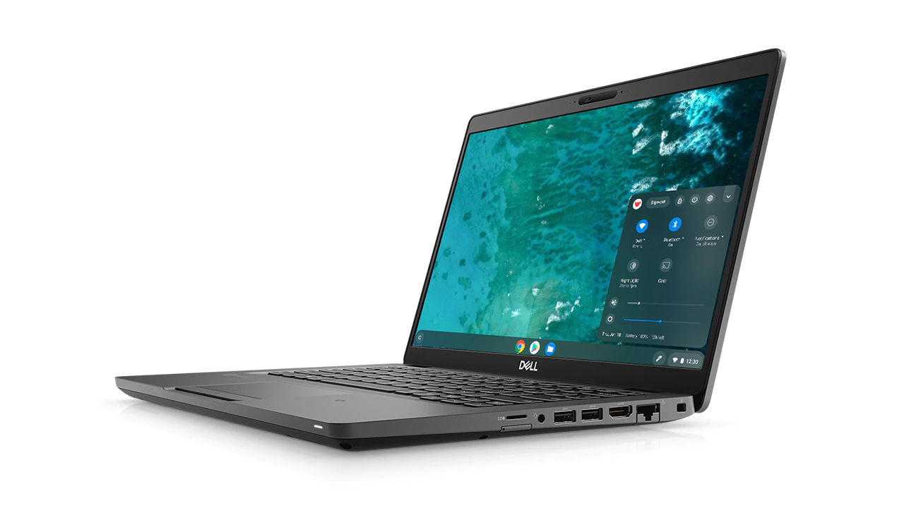
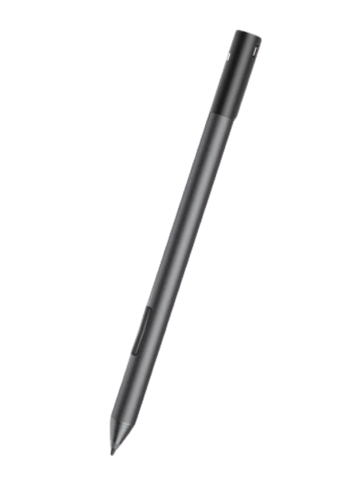
… enabled thanks to a modern device: Chromebook
10h autonomy
Touchscreen
90% charge in 90 min, USB-C
Offline mode
Tablet mode
Google Meet & SAP without VPN
Cloud for App & data
Print at home
Move your token to your smartphone
External monitor compatible
Same processor and memory as PC
Automatic update
Start in 8 sec
Data encrypted
Travel dock station USB-C

Slide 11
3 - CREW program for Marketing & Sales

Slide 12
Chromebook fits Marketing & Sales needs
MAIN APPLICATION AVAILABLE
SAP
CRM Salesforce.com
Think cell (user demo video)
Google Sheets
Google Slides
Google Docs
Dynasys
Sinequa
Qlikview
Miro
Teams, Skype, Zoom
USE CASE EXAMPLES:
Collaborate with Customer:
Customer meeting with Gmeets (compatible with non Google emails)
Teams, Skype, Zoom available if required by the customer
Product Presentation using Chromebook as a tablet
Brainstorming with customer using Jamboard
Contract signing with Chromebook touchscreen (no printing needed)
Contract Management with Gdocs collaborative features
Traveling:
Light weigh, Battery autonomy 10h
Tablet mode to read documents & reports in the train, plane or metro
Working on document without internet
Collaborate internally:
Brainstorming with Jamboard
Automatic import in Gsheets with Salesforce connector
Team meeting using GMeet, breakout rooms and recording feature
Team organization with a dedicated Google Calendar
Collaboration with the real time editing & commenting feature
SOME FIGURES:
80% of compatibility in last Marketing & Sales Novecare CREW sprint
Chromebook under deployment in other GBUs as well, for example, 65% of the Marketing & Sales in Aroma Performance equipped with Chromebook

Slide 13
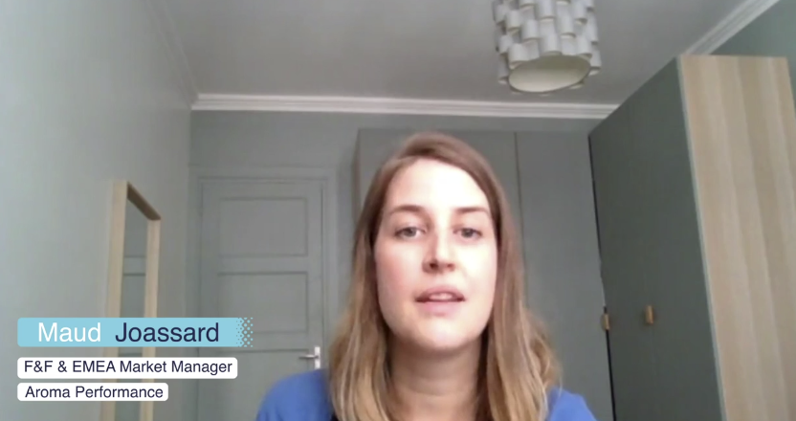
Marketing & Sales colleagues talk about Chromebook
Moving from a PC to a Chromebook
Mobility and Time saving
“For me mobility is the most important thing...” … Matthias Foerster Regional Market Director
“My move from a PC to a Chromebook was in fact not that big.” … Maud Joassard, Marketing Manager
Data treatment and visualisation
Flexibility, Mobility and Versatility
“ It's really the flexibility that is superior to any other laptop I've ever had before.” … Marco Gannuzo Business Director
“It allow us to save time on recurring tasks.” … Diego Rizzo, Strategic marketing analyst

Slide 14
6 weeks sprint
We are here
WEEK 1
WEEK 2
WEEK 3
WEEK 4
WEEK 5
WEEK 6
- Validate your Chromebook eligibility & Detect potential exceptions
- Receive your Chromebook on time for training sessions
- Convert your macros if you have
Q&A session with CREW team
Communication and Gform
2021 A Solvay Space Odyssey l
- 1h00 -
Guardians of the Galaxy
- 2h00 -
Detox Busters
- 1h00 -
2021 A Solvay Space Odyssey ll
- 1h00 -
Kick-off communication
- 1h -
Start to
use Virtus
→ Project presentation, objectives and next steps
Change Management
→ Mindset expected, sharing of challenges, fears
→ Are you eager to know more about Google?
Smart Meeting
Work as a Team
Road Warriors
Work with Externals
→ Google Vs MS approach, mindset and process demystification with Google
Virtus
→ Virtus presentation, working with Virtus
→ Q&A session to answer all remaining doubts and questions.
Request
Chromebook delivery
Move files to Cloud:
Migrate you file located in your local hard disk to Gdrive before week 6 - Chromebook delivery thanks to this guideline
eLearning YouGrow:
Let’s go deeper into the Google Workspace world!
→ Onboarding, Smart Meeting, Work as a Team, Road Warriors, Work with Externals

Slide 15
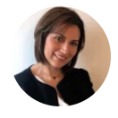
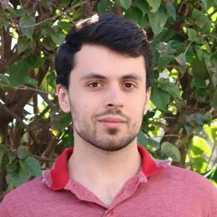
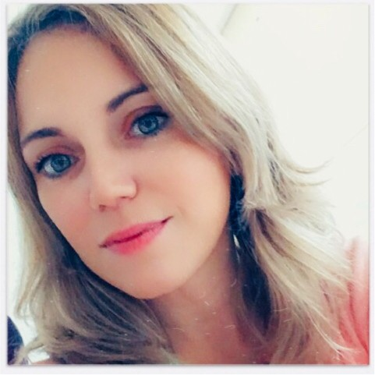
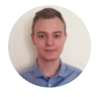
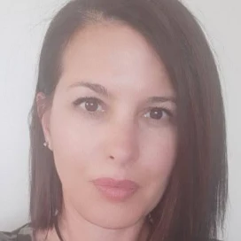
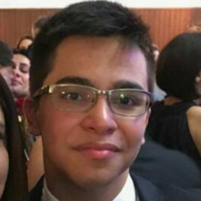
CREW project team
Change & Google Manager
Ricardo Jacob
Change Management Specialist EMEA
Alysheea Prabhagar
Google & Change Management Specialist APAC
Anna Karolina
Google & Change Management NAM/LAM
Adélaïde Malthet
Continuous Improvement and Agile Coaching
Fabiola Zozaya
Remediation Manager
Amauri Barros
Remediation
Carlos Giusti Project Manager
Clémence Allepuz
Customer Success Manager
Bruno Graça
Customer Success
Marta Guimarães
Communication Manager
Gaetan Hetet
Chromebook delivery Manager
Mathieu Humbert
Chromebook Delivery
Sabrina Robin
Chromebook Delivery
João Paulo Pereira
Chromebook Delivery
Michaud Tegera
Chromebook Delivery
A question? Join our weekly 3Cs [CREW, Chromebook & Coffee] sessions and meet the team > HERE <

Slide 16
Useful Chromebook & Google resources
- Chromebook -
Solvay material
- Google Workspace - Solvay material
- Google Workspace - Google material
Lite Device community
Google Collaboration community
Google workspace support
Lite Device Chromebook site
YouGrow Google eLearning
G Suite workspace
Apps availability in Virtus
Gommunity Google site
Chromebook / Virtus FAQ
Subscribe to Google update
A question? Join our weekly 3Cs [CREW, Chromebook & Coffee] sessions and meet the team > HERE <

Slide 17
4 - Q&A time
A question? Join our weekly 3Cs [CREW, Chromebook & Coffee] sessions and meet the team > HERE <

Slide 18
5 - Next steps

Slide 19
Next steps
Complete the Gform ( Novecare here / volunteers here)
Participate to the training sessions
Migrate your files to Google Drive ( guideline available)

